Slide 1
22AI401 - MACHINE LEARNING
UNIT I INTRODUCTION 9+6
Machine Learning – Types – Applications – Preparing to Model – Activities – Data – Exploring structure of Data – Data Quality and Remediation – Data Pre-processing – Modelling and Evaluation: Selecting a Model -Training a Model – Model representation and Interpretability – Evaluating Performance of a Model – Improving Performance.

Slide 2
TYPES OF HUMAN LEARNING
Learning under expert guidance
Learning guided by knowledge gained from experts
Learning by self

Slide 3
MACHINE LEARNING
‘A computer program is said to learn from experience E with respect to some class of tasks T and performance measure P, if its performance at tasks in T, as measured by P, improves with experience E.’

Slide 4
WHAT IS MACHINE LEARNING?
Example:
Image classification problem E represents the past data with images having labels or assigned classes (for example whether the image is of a class cat or a class dog or a class elephant etc.), T is the task of assigning class to new, unlabelled images and P is the performance measure indicated by the percentage of images correctly classified.

Slide 5
The basic machine learning process can be divided into three parts.
1. Data Input: Past data or information is utilized as a basis for future decision-making
2. Abstraction: The input data is represented in a broader way through the underlying algorithm
3. Generalization: The abstracted representation is generalized to form a framework for making decisions

Slide 6
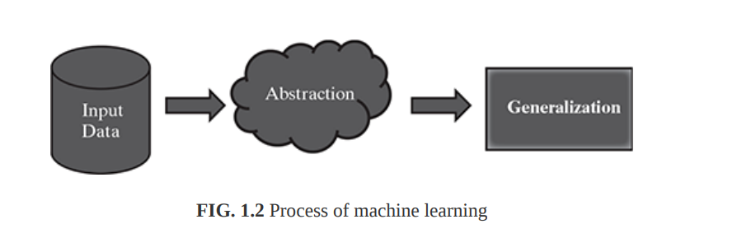
Figure 1.2 is a schematic representation of the machine learning process.

Slide 7
Abstraction
During the machine learning process, knowledge is fed in the form of input data. However, the data cannot be used in the original shape and form. As we saw in the example above, abstraction helps in deriving a conceptual map based on the input data. This map, or a model as it is known in the machine learning paradigm, is summarized knowledge representation of the raw data. The model may be in any one of the following forms :
Computational blocks like if/else rules
Mathematical equations
Specific data structures like trees or graphs
Logical groupings of similar observations

Slide 8
This process of fitting the model based on the input data is known as training. Also, the input data based on which the model is being finalized is known as training data.

Slide 9
Generalization
The first part of machine learning process is abstraction i.e. abstract the knowledge which comes as input data in the form of a model. However, this abstraction process, or more popularly training the model, is just one part of machine learning. The other key part is to tune up the abstracted knowledge to a form which can be used to take future decisions. This is achieved as a part of generalization.

Slide 10
Well-posed learning problem
For defining a new problem, which can be solved using machine learning, a simple framework, highlighted below, can be used.
1. What is the problem?
2. Why does the problem need to be solved?
3. How to solve the problem?

Slide 11
Well-posed learning problem
Step 1: What is the Problem?
Describe the problem informally and formally and list assumptions and similar problems.
Informal description of the problem, e.g. I need a program that will prompt the next word as and when I type a word.
Formalism
Use Tom Mitchell’s machine learning formalism stated above to define the T, P, and E for the problem.
For example:
Task (T): Prompt the next word when I type a word.
Experience (E): A corpus of commonly used English words and phrases.
Performance (P): The number of correct words prompted considered as a
percentage (which in machine learning paradigm is known as learning accuracy).
Assumptions - Create a list of assumptions about the problem.
Similar problems- What other problems have you seen or can you think of that are similar to the problem that you are trying to solve?

Slide 12
Well-posed learning problem
Step 2: Why does the problem need to be solved?
Motivation→ What is the motivation for solving the problem? What requirement will it fulfil?
(Ex: solve any long standing issues like transaction fraudulent in bank)
Solution benefits→ It is important to clearly understand the benefits of solving the problem. These benefits can be articulated to sell the project.
Solution use → How will the solution to the problem be used and the life time of the solution is expected to have?

Slide 13
Well-posed learning problem
Step 3: How would I solve the problem?
Try to explore how to solve the problem manually.
Detail out step-by-step data collection, data preparation, and program design to solve the problem. Collect all these details and update the previous sections of the problem definition,especially the assumptions.

Slide 14
UNIT I INTRODUCTION 9+6
Machine Learning – Types – Applications – Preparing to Model – Activities – Data – Exploring structure of Data – Data Quality and Remediation – Data Pre-processing – Modelling and Evaluation: Selecting a Model -Training a Model – Model representation and Interpretability – Evaluating Performance of a Model – Improving Performance.

Slide 15
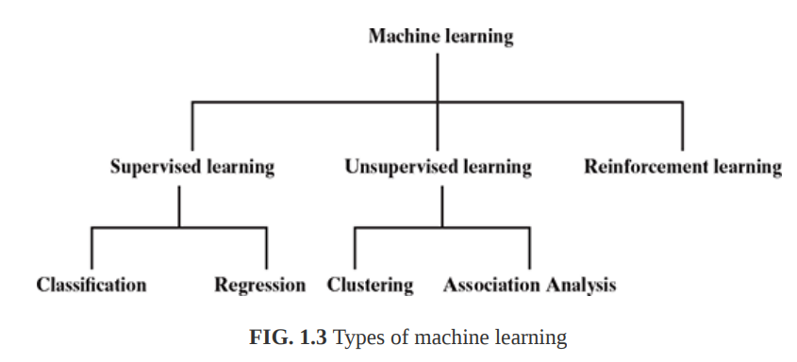
TYPES OF MACHINE LEARNING

Slide 16
1.Supervised learning – Also called predictive learning. A machine predicts the class of unknown objects based on prior class-related information of similar objects.
2. Unsupervised learning – Also called descriptive learning. A machine finds patterns in unknown objects by grouping similar objects together.
3. Reinforcement learning – A machine learns to act on its own to achieve the given goals.

Slide 17
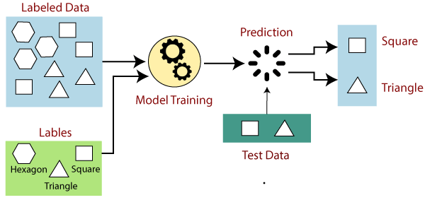
Supervised Learning
If the given shape has four sides, and all the sides are equal, then it will be labelled
Square
If the given shape has three sides, then it will be labelled
Triangle
If the given shape has six equal sides then it will be labelled
Hexagon

Slide 18
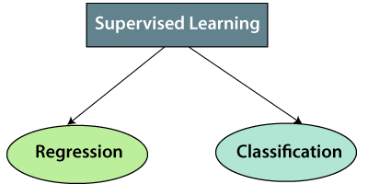
Types of supervised Machine learning Algorithms:
It is used for the prediction of continuous variables, such as Weather forecasting, Market Trends, etc
Classification algorithms are used when the output variable is categorical, which means there are two classes such as Yes-No, Male-Female, True-false, etc.
Regression algorithms which come under supervised learning:
Linear Regression
Regression Trees
Non-Linear Regression
Bayesian Linear Regression
Polynomial Regression
Random Forest
Decision Trees
Logistic Regression
Support vector Machines

Slide 19
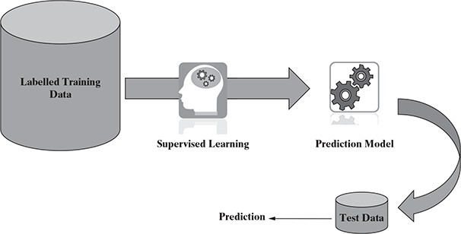
Supervised Learning
Some examples of supervised learning are
Predicting the results of a game
Predicting whether a tumour is malignant or benign
Predicting the price of domains like real estate, stocks, etc.
Classifying texts such as classifying a set of emails as spam or non-spam

Slide 20
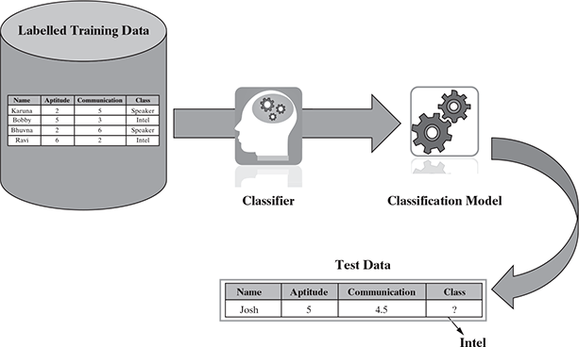
Supervised Learning- Classification
Some examples
popular machine learning algorithms
which help in solving classification problems. Naïve Bayes
Decision tree
k-Nearest Neighbour
Some typical classification problems include:
Image classification
Prediction of disease
Win–loss prediction of games
Prediction of natural calamity like earthquake, flood, etc.
Recognition of handwriting

Slide 21
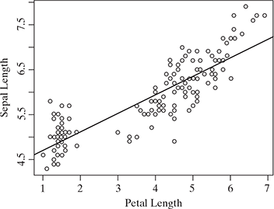
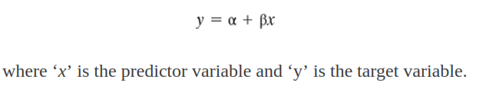
Supervised Learning- Regression
Typical applications of regression can be seen in
Demand forecasting in retails
Sales prediction for managers
Price prediction in real estate
Weather forecast
Skill demand forecast in job market

Slide 22
1.Supervised learning
A machine needs the basic information to be provided to it. This basic input, or the experience in the paradigm of machine learning, is given in the form of training data . Training data is the past information on a specific task. In context of the image segregation problem, training data will have past data on different aspects or features on a number of images, along with a tag on whether the image is round or triangular, or blue or green in colour. The tag is called ‘ label’ and we say that the training data is labelled in case of supervised learning.

Slide 23
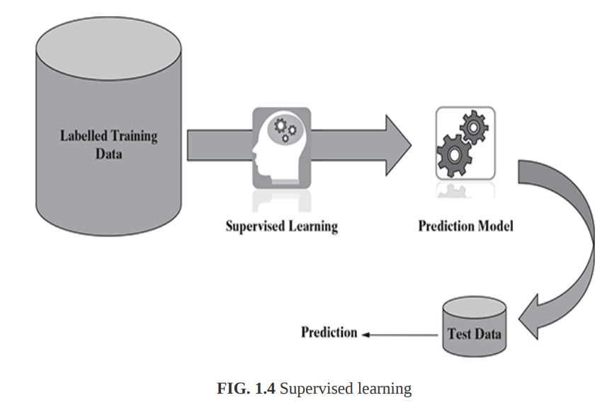
Labelled training data containing past information comes as an input. Based on the training data, the machine builds a predictive model that can be used on test data to assign a label for each record in the test data.

Slide 24
When we are trying to predict a categorical or nominal variable, the problem is known as a classification problem.
Whereas when we are trying to predict a real-valued variable, the problem falls under the category of regression.
Supervised machine learning is as good as the data used to train it. If the training data is of poor quality, the prediction will also be far from being precise.

Slide 25
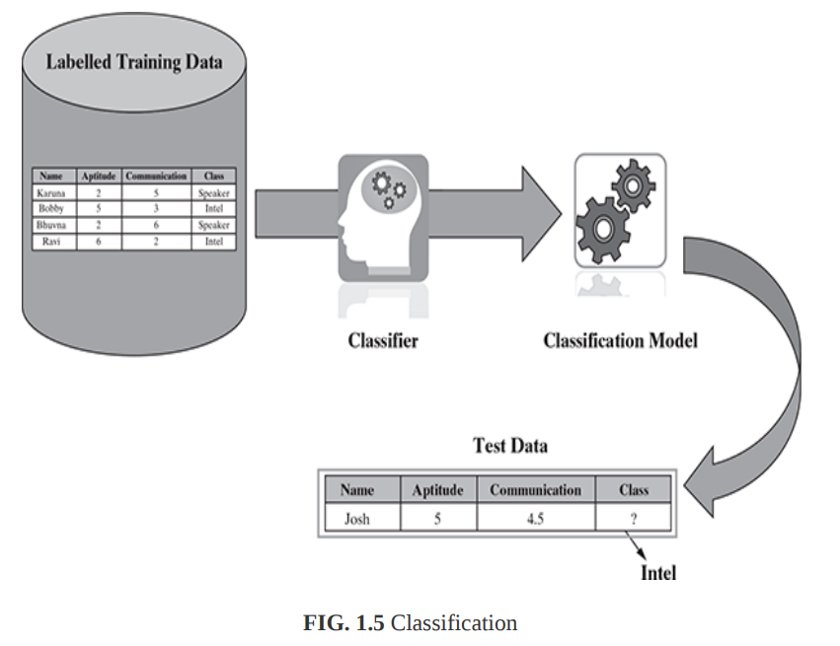
Classification:
we observe that the whole problem revolves around assigning a label or category or class to a test data based on the label or category or class information that is imparted by the training data. Since the target objective is to assign a class label, this type of problem as classification problem.
Naïve Bayes,
Decision tree, and
k-Nearest Neighbour algorithms

Slide 26
classification is a type of supervised learning where a target feature, which is of type categorical, is predicted for test data based on the information imparted by training data. The target categorical feature is known as class.
Some typical classification problems include:
Image classification Prediction of disease
Win–loss prediction of games
Prediction of natural calamity like earthquake, flood, etc.
Recognition of handwriting

Slide 27
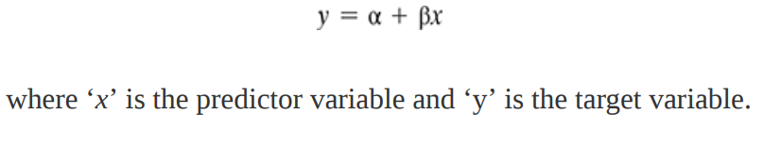
Regression
In case of linear regression, a straight line relationship is ‘fitted’ between the predictor variables and the target variables, using the statistical concept of least squares method.
As in the case of least squares method, the sum of square of error between actual and predicted values of the target variable is tried to be minimized.
. In case of simple linear regression, there is only one predictor variable whereas in case of multiple linear regression, multiple predictor variables can be included in the model.
A typical linear regression model can be represented in the form –

Slide 28
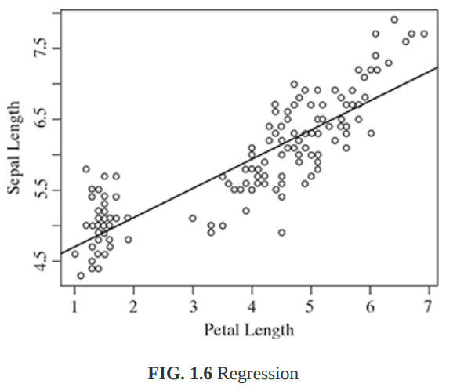
Typical applications of regression can be seen in
Demand forecasting in retails
Sales prediction for managers
Price prediction in real estate
Weather forecast
Skill demand forecast in job market

Slide 29
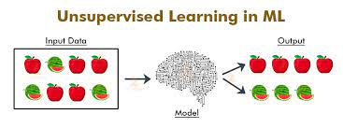
Un supervised Learning
Unlablled Data
Without any supervision
Finding patterns from data

Slide 30
Why use Unsupervised Learning?
Unsupervised learning is helpful for finding useful insights from the data.
Unsupervised learning is much similar as a human learns to think by their own experiences, which makes it closer to the real AI.
Unsupervised learning works on unlabeled and uncategorized data which make unsupervised learning more important.

Slide 31
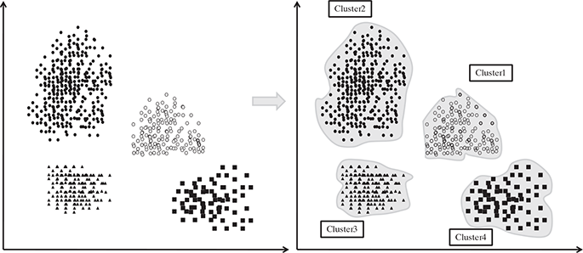
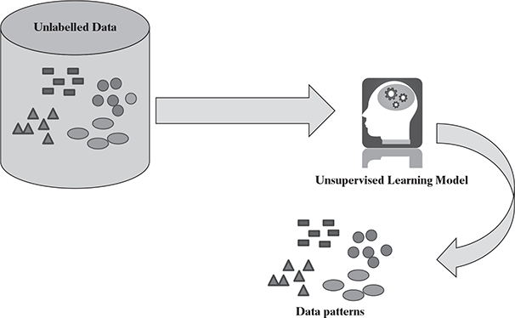
UnSupervised Learning

Slide 32
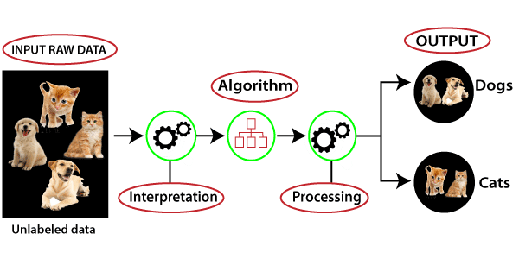
Working of Un supervised Learning

Slide 33
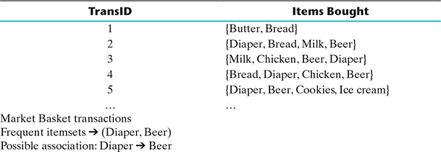
UnSupervised Learning
FIG. Market basket analysis

Slide 34
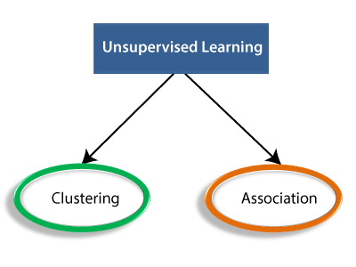
Types of Unsupervised Learning Algorithm:
finding the relationships between variables in the large database
Grouping the objects into clusters

Slide 35
Advantages of Unsupervised Learning
Unsupervised learning is used for more complex tasks as compared to supervised learning because, in unsupervised learning, we don't have labeled input data.
Unsupervised learning is preferable as it is easy to get unlabeled data in comparison to labeled data.
Disadvantages of Unsupervised Learning
Unsupervised learning is intrinsically more difficult than supervised learning as it does not have corresponding output.
The result of the unsupervised learning algorithm might be less accurate as input data is not labeled, and algorithms do not know the exact output in advance.

Slide 36
Unsupervised learning
Unlike supervised learning, in unsupervised learning, there is no labelled training data to learn from and no prediction to be made. In unsupervised learning, the objective is to take a dataset as input and try to find natural groupings or patterns within the data elements or records. Therefore, unsupervised learning is often termed as descriptive model and the process of unsupervised learning is referred as pattern discovery or knowledge discovery. One critical application of unsupervised learning is customer segmentation.

Slide 37
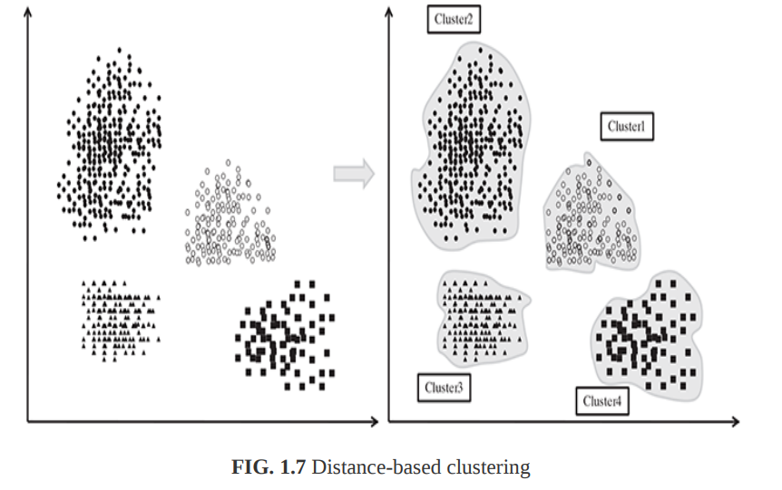
Clustering is the main type of unsupervised learning

Slide 38
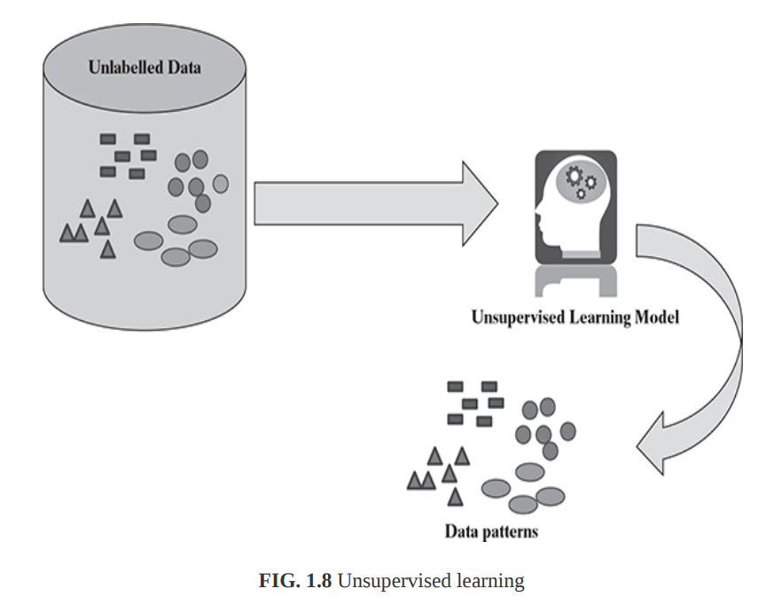
Other than clustering of data and getting a summarized view from it, one more variant of unsupervised learning is association analysis.

Slide 39
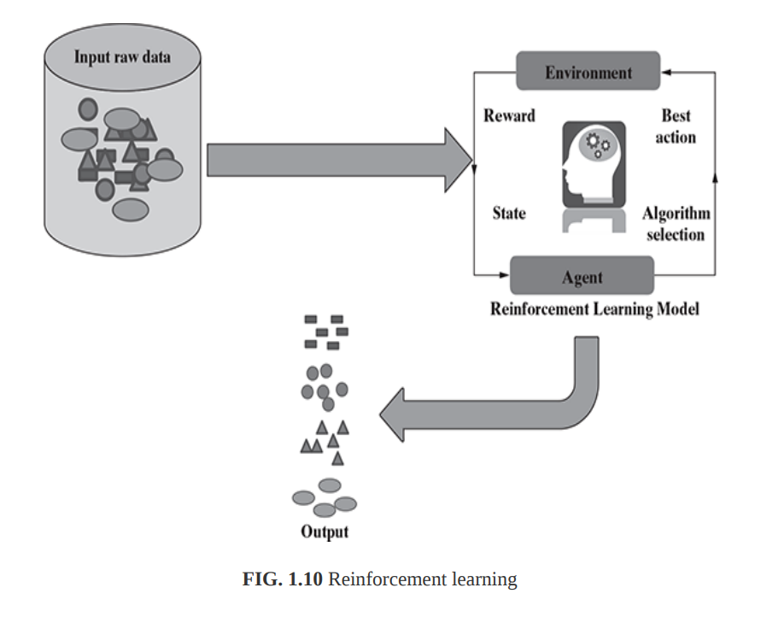
Reinforcement learning
One contemporary example of reinforcement learning is self-driving cars.

Slide 40

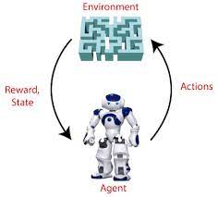
Reinforcement Learning
Learn from experience

Slide 41
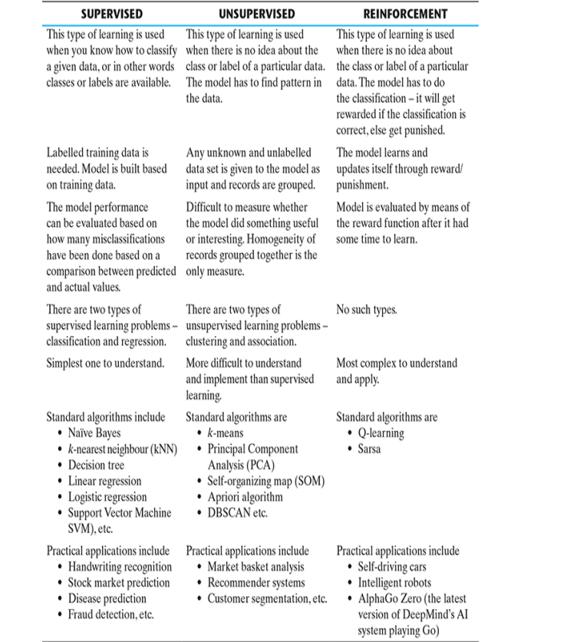

Slide 42
UNIT I INTRODUCTION 9+6
Machine Learning – Types – Applications – Preparing to Model – Activities – Data – Exploring structure of Data – Data Quality and Remediation – Data Pre-processing – Modelling and Evaluation: Selecting a Model -Training a Model – Model representation and Interpretability – Evaluating Performance of a Model – Improving Performance.

Slide 43
APPLICATIONS OF MACHINE LEARNING
Banking and finance
Insurance
Healthcare
Image Recognition
Speech Recognition
Traffic prediction
Product recommendations
Self-driving cars
Email Spam and Malware Filtering
Virtual Personal Assistant
Online Fraud Detection
Stock Market trading
Medical Diagnosis
Automatic Language Translation

Slide 44
UNIT I INTRODUCTION 9+6
Machine Learning – Types – Applications – Preparing to Model – Activities – Data – Exploring structure of Data – Data Quality and Remediation – Data Pre-processing – Modelling and Evaluation: Selecting a Model -Training a Model – Model representation and Interpretability – Evaluating Performance of a Model – Improving Performance.

Slide 45
Preparing to Model
MACHINE LEARNING ACTIVITIES
Following are the typical preparation activities done once the input data comes into the machine learning system:
Understand the type of data in the given input data set.
Explore the data to understand the nature and quality.
Explore the relationships amongst the data elements, e.g. inter-feature relationship.
Find potential issues in data.
Do the necessary remediation, e.g. impute missing data values, etc., if needed.
Apply pre-processing steps, as necessary.
Once the data is prepared for modelling, then the learning tasks start off. As a part of it, do the following activities:
The input data is first divided into parts – the training data and the test data (called holdout). This step is applicable for supervised learning only.
Consider different models or learning algorithms for selection.
Train the model based on the training data for supervised learning problem and apply to unknown data. Directly apply the chosen unsupervised model on the input data for unsupervised learning problem

Slide 46
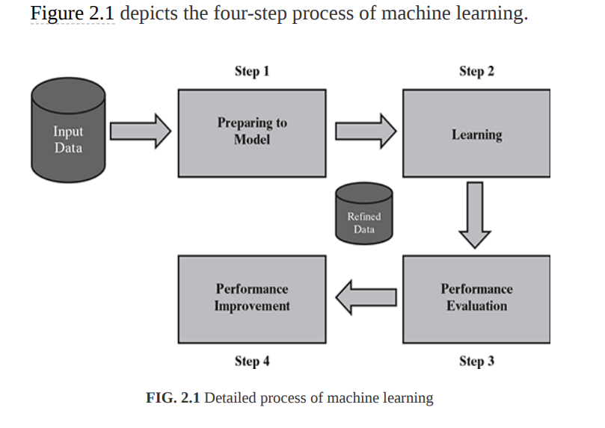

Slide 47
UNIT I INTRODUCTION 9+6
Machine Learning – Types – Applications – Preparing to Model – Activities – Data – Exploring structure of Data – Data Quality and Remediation – Data Pre-processing – Modelling and Evaluation: Selecting a Model -Training a Model – Model representation and Interpretability – Evaluating Performance of a Model – Improving Performance.

Slide 48
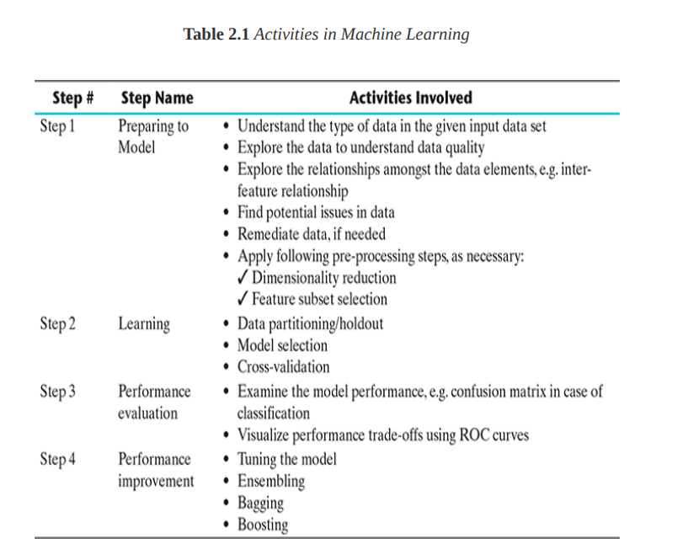

Slide 49
UNIT I INTRODUCTION 9+6
Machine Learning – Types – Applications – Preparing to Model – Activities – Data – Exploring structure of Data – Data Quality and Remediation – Data Pre-processing – Modelling and Evaluation: Selecting a Model -Training a Model – Model representation and Interpretability – Evaluating Performance of a Model – Improving Performance.

Slide 50
BASIC TYPES OF DATA IN MACHINE LEARNING
A data set is a collection of related information or records.
Each row of a data set is called a record.
Each data set also has multiple attributes, each of which gives information on a specific characteristic.

Slide 51
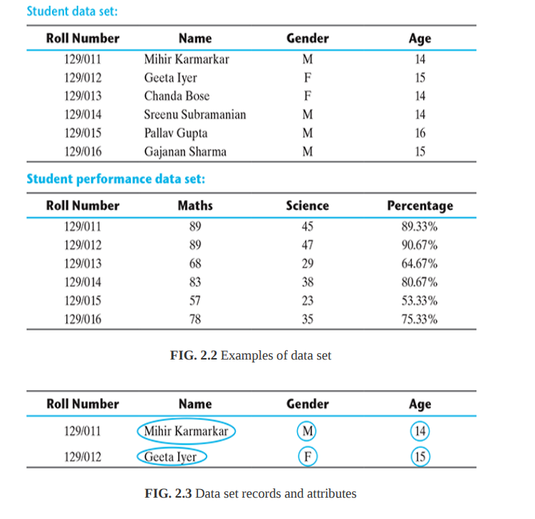

Slide 52
Data can broadly be divided into following two types:
1. Qualitative data
2. Quantitative data
Qualitative data provides information about the quality of an object or information which cannot be measured.
Qualitative data is also called categorical data.
Qualitative data can be further subdivided into two types as follows: 1. Nominal data 2. Ordinal data

Slide 53
Nominal data is one which has no numeric value, but a named value. It is used for assigning named values to attributes.
Nominal values cannot be quantified. Examples of nominal data are
1. Blood group: A, B, O, AB, etc.
2. Nationality: Indian, American, British, etc.
3. Gender: Male, Female, Other
It is obvious, mathematical operations such as addition, subtraction, multiplication, etc. cannot be performed on nominal data. For that reason, statistical functions such as mean, variance, etc. can also not be applied on nominal data. a basic count is possible.

Slide 54
Ordinal data, in addition to possessing the properties of nominal data, can also be naturally ordered.
This means ordinal data also assigns named values to attributes but unlike nominal data, they can be arranged in a sequence of increasing or decreasing value so that we can say whether a value is better than or greater than another value.
Like nominal data, basic counting is possible for ordinal data. Hence, the mode can be identified. Since ordering is possible in case of ordinal data, median, and quartiles can be identified in addition. Mean can still not be calculated.
Examples of ordinal data are
1. Customer satisfaction: ‘Very Happy’, ‘Happy’, ‘Unhappy’, etc.
2. Grades: A, B, C, etc.
3. Hardness of Metal: ‘Very Hard’, ‘Hard’, ‘Soft’, etc.

Slide 55
Quantitative data relates to information about the quantity of an object – hence it can be measured.
Quantitative data is also termed as numeric data. There are two types of quantitative data:
1. Interval data
2. Ratio data
Interval data is numeric data for which not only the order is known, but the exact difference between values is also known. An ideal example of interval data is Celsius temperature.
For interval data, mathematical operations such as addition and subtraction are possible. For that reason, for interval data, the central tendency can be measured by mean, median, or mode. Standard deviation can also be calculated.

Slide 56
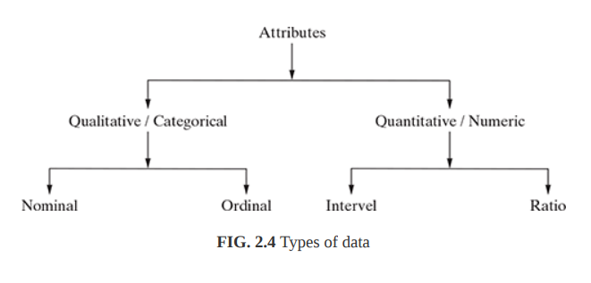
Ratio data represents numeric data for which exact value can be measured.
Absolute zero is available for ratio data. Also, these variables can be added, subtracted, multiplied, or divided.
The central tendency can be measured by mean, median, or mode and methods of dispersion such as standard deviation. Examples of ratio data include height, weight, age, salary, etc.

Slide 57
The attributes can be either discrete or continuous based on this factor.
Discrete attributes can assume a finite or countably infinite number of values. Nominal attributes such as roll number, street number, pin code, etc. can have a finite number of values whereas numeric attributes such as count, rank of students, etc. can have countably infinite values. A special type of discrete attribute which can assume two values only is called binary attribute. Examples of binary attribute include male/ female, positive/negative, yes/no, etc.
Continuous attributes can assume any possible value which is a real number. Examples of continuous attribute include length, height, weight, price, etc.

Slide 58
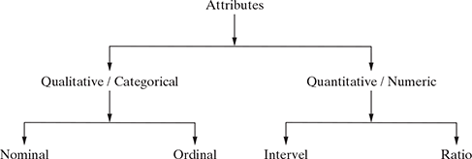
Data Types

Slide 59
Qualitative data provides information about the quality of an object or information which cannot be measured
Nominal data is one which has no numeric value, but a named value
1. Blood group: A, B, O, AB, etc.
2. Nationality: Indian, American, British, etc.
3. Gender: Male, Female, Other
Ordinal data, arranged in a sequence of increasing or decreasing value
Examples
1. Customer satisfaction: ‘Very Happy’, ‘Happy’, ‘Unhappy’, etc.
2. Grades: A, B, C, etc.
3. Hardness of Metal: ‘Very Hard’, ‘Hard’, ‘Soft’, etc.
Quantitative data relates to information about the quantity of an object
Interval data is numeric data for which not only the order is known, but the exact difference between values is also known.
Examples include date, time, etc.
mathematical operations→ Addition, Subtraction, Multiplication
Central Tendency measured by → mean,median, or mode
Standard deviation can also be calculated.
interval data do not have something called a ‘true zero’ value

Slide 60
Ratio data represents numeric data for which exact value can be measured. Absolute zero is available for ratio data.
these variables can be added, subtracted, multiplied, or divided.
The central tendency can be measured by mean,median, or mode and methods of dispersion such as standard deviation.
Examples of ratio data include height, weight, age,salary, etc.
In addition to above types
The attributes can be either discrete or continuous based on this factor.
Discrete attributes can assume a finite or countably infinite number of values.
Nominal attributes such as roll number,street number, pin code, etc. can have a finite number of values Numeric attributes such as count, rank of students, etc. can have countably infinite values.
A special type of discrete attribute is called binary attribute.
Examples → male/ female, positive/negative, yes/no, etc.
Continuous attributes can assume any possible value which is a real number.
Examples of continuous attribute include length, height, weight, price, etc.

Slide 61
UNIT I INTRODUCTION 9+6
Machine Learning – Types – Applications – Preparing to Model – Activities – Data – Exploring structure of Data – Data Quality and Remediation – Data Pre-processing – Modelling and Evaluation: Selecting a Model -Training a Model – Model representation and Interpretability – Evaluating Performance of a Model – Improving Performance.

Slide 62
EXPLORING STRUCTURE OF DATA
two basic data types – numeric and categorical.
In case of a standard data set, we may have the data dictionary available for reference. Data dictionary is a metadata repository, i.e. the repository of all information related to the structure of each data element contained in the data set. The data dictionary gives detailed information on each of the attributes – the description as well as the data type and other relevant details.
In case the data dictionary is not available, we need to use standard library function of the machine learning tool that we are using and get the details.

Slide 63
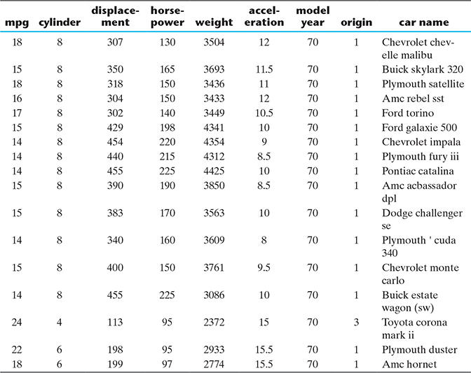
EXPLORING STRUCTURE OF DATA
The data set that we take as a reference is the Auto MPG data set available in the UCI repository
This data set is regarding prediction of fuel consumption in miles per gallon, i.e. the numeric attribute ‘mpg’ is the target attribute.

Slide 64
EXPLORING STRUCTURE OF DATA
Exploring numerical data
Understanding central tendency
Understanding data spread
Plotting and exploring numerical data
Box plots
Histogram
Exploring categorical data
Exploring relationship between variables
Scatter plot
Two-way cross-tabulations

Slide 65
An outlier is a data point that significantly deviates from the rest of the data. It can be either much higher or much lower than the other data points, and its presence can have a significant impact on the results of machine learning algorithms. They can be caused by measurement or execution errors.
Unusually high or unusually low

Slide 66
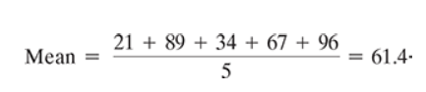
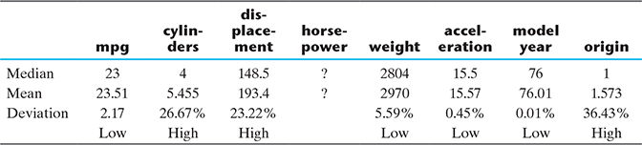
EXPLORING STRUCTURE OF DATA
Understanding central tendency → For example, mean of a set of observations
21, 89, 34, 67, and 96 is calculated as below.
The chance of these attributes
having too many outlier values is less
Median
21, 34, 67,89, 96
Mean and median are impacted differently by data values appearing at the beginning or at the end of the range.

Slide 67
EXPLORING STRUCTURE OF DATA
Understanding central tendency
The chance of these attributes
having too many outlier values is less
Median
21, 34, 67,89, 96
Mean and median are impacted differently by data values appearing at the beginning or at the end of the range.

Slide 68
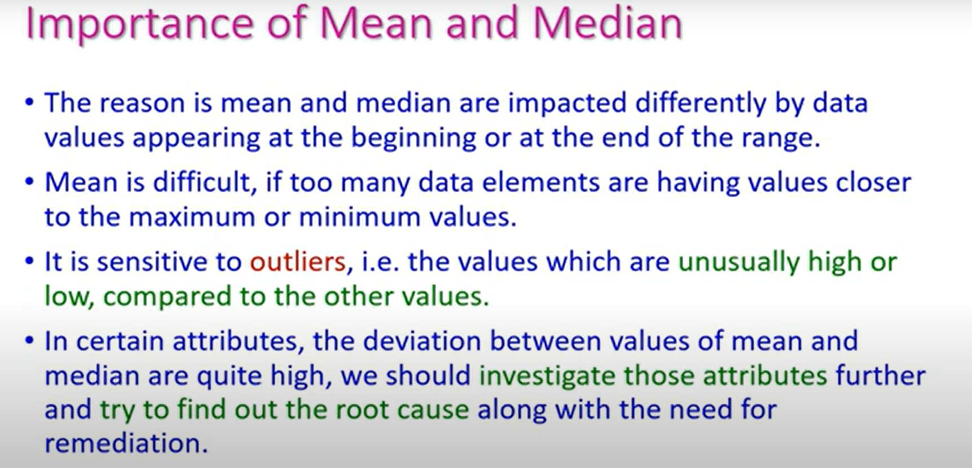

Slide 69
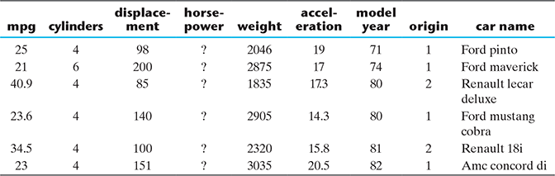
EXPLORING STRUCTURE OF DATA
Missing values of attribute ‘horsepower’ in Auto MPG

Slide 70
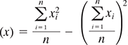
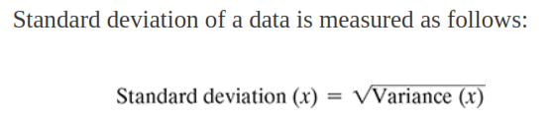
EXPLORING STRUCTURE OF DATA
Understanding data spread
data spread in the form of
1. Dispersion of data
2. Position of the different data values
Consider the data values of two attributes
1. Attribute 1 values : 44, 46, 48, 45, and 47
2. Attribute 2 values : 34, 46, 59, 39, and 52
To measure the extent of dispersion of a data,or to find out how much the different values of a data are
spread out, the variance of the data is measured.
The variance of a data is measured using the formula given below:
where x is the variable or attribute whose variance is to be measured n is the number of observations or values of variable x.
Larger value of variance or standard deviation indicates
more dispersion in the data and vice versa

Slide 71
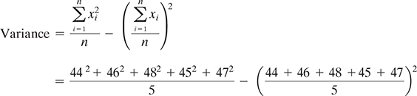
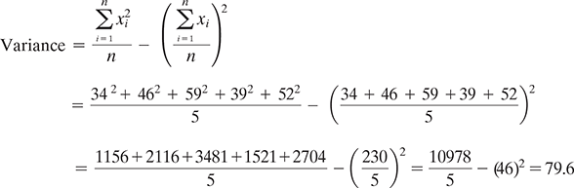
EXPLORING STRUCTURE OF DATA
Consider the data values of two attributes
1. Attribute 1 values : 44, 46, 48, 45, and 47
2. Attribute 2 values : 34, 46, 59, 39, and 52
For attribute 2,

Slide 72
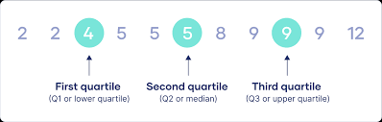
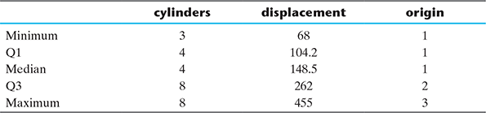
EXPLORING STRUCTURE OF DATA
Understanding data spread
Measuring data value position

Slide 73
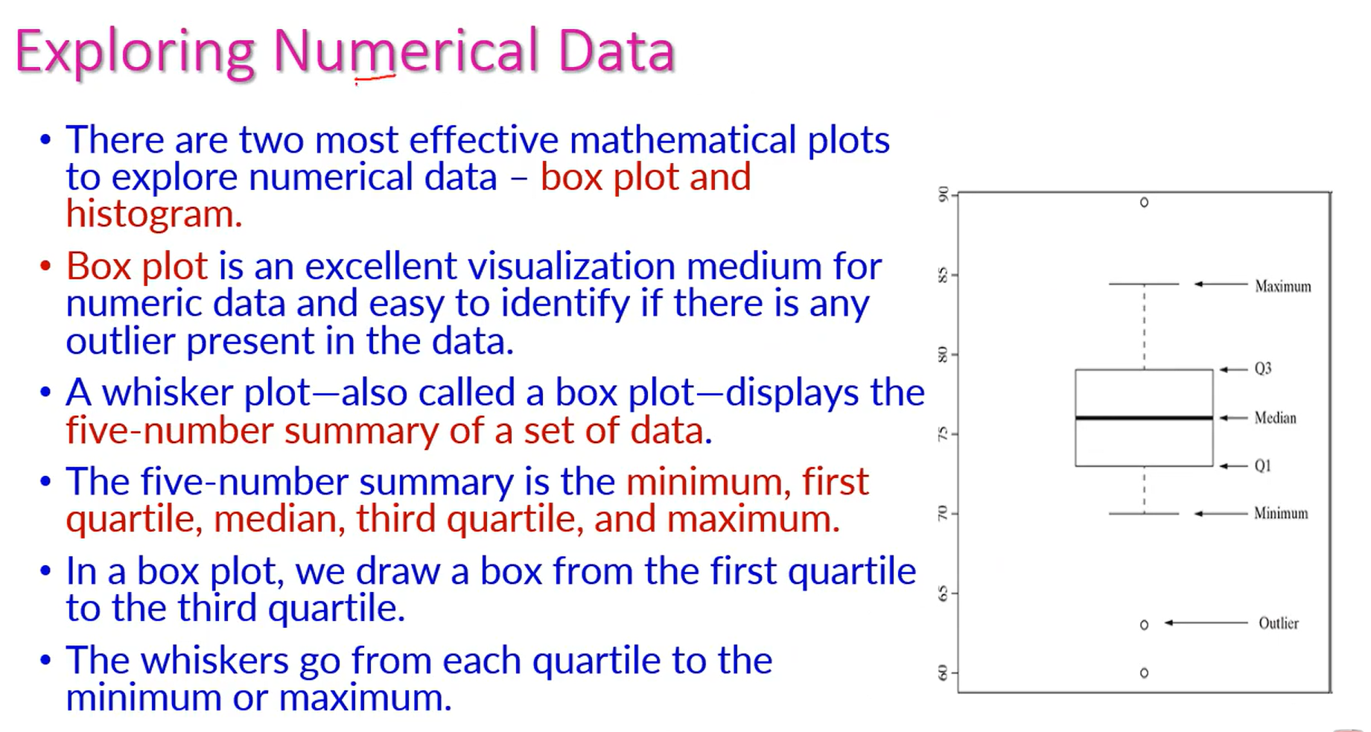

Slide 74
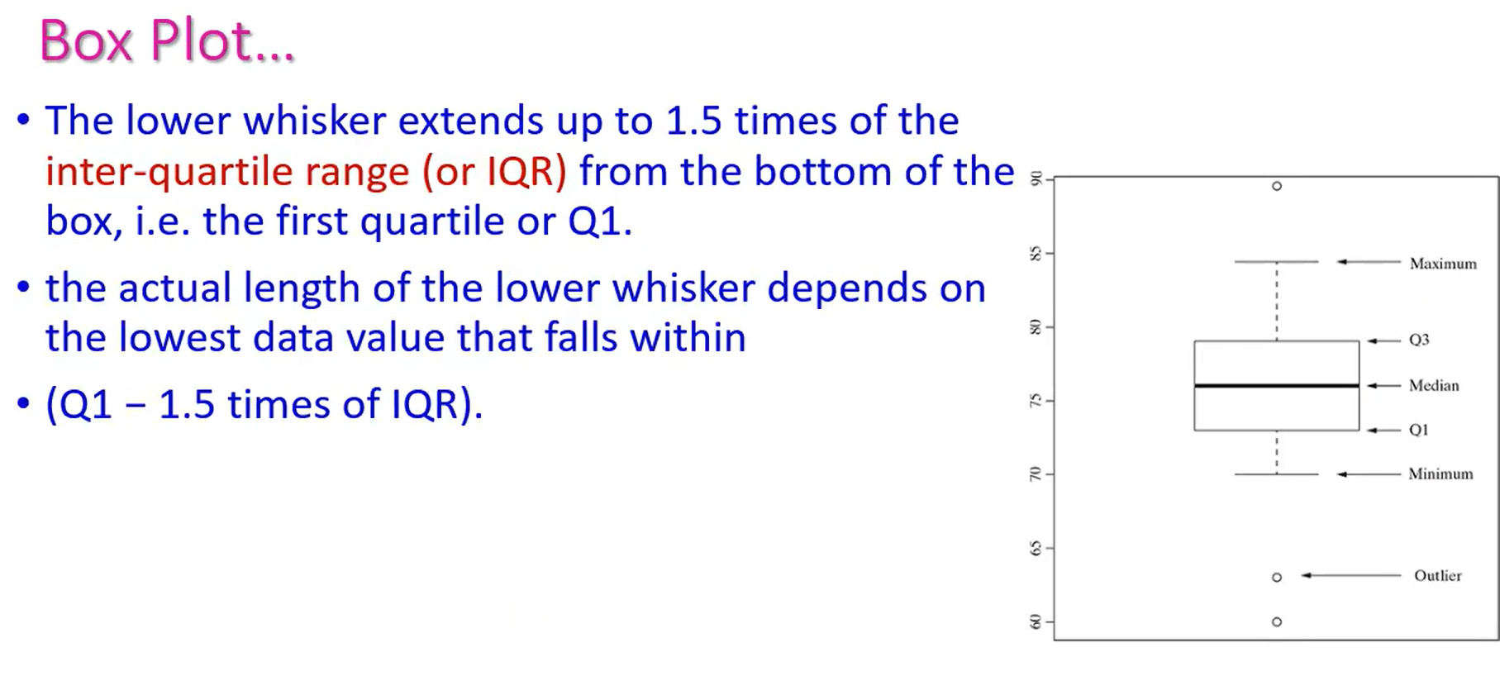

Slide 75
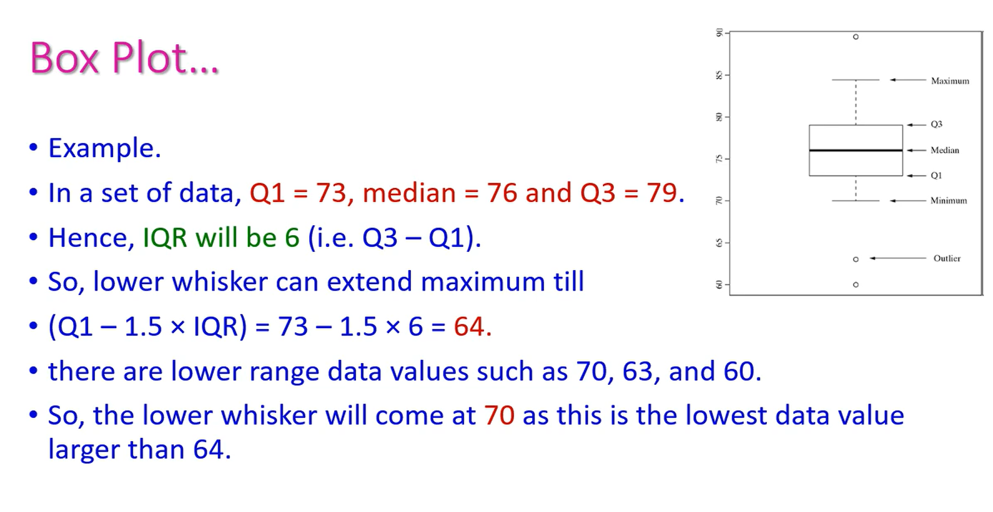

Slide 76
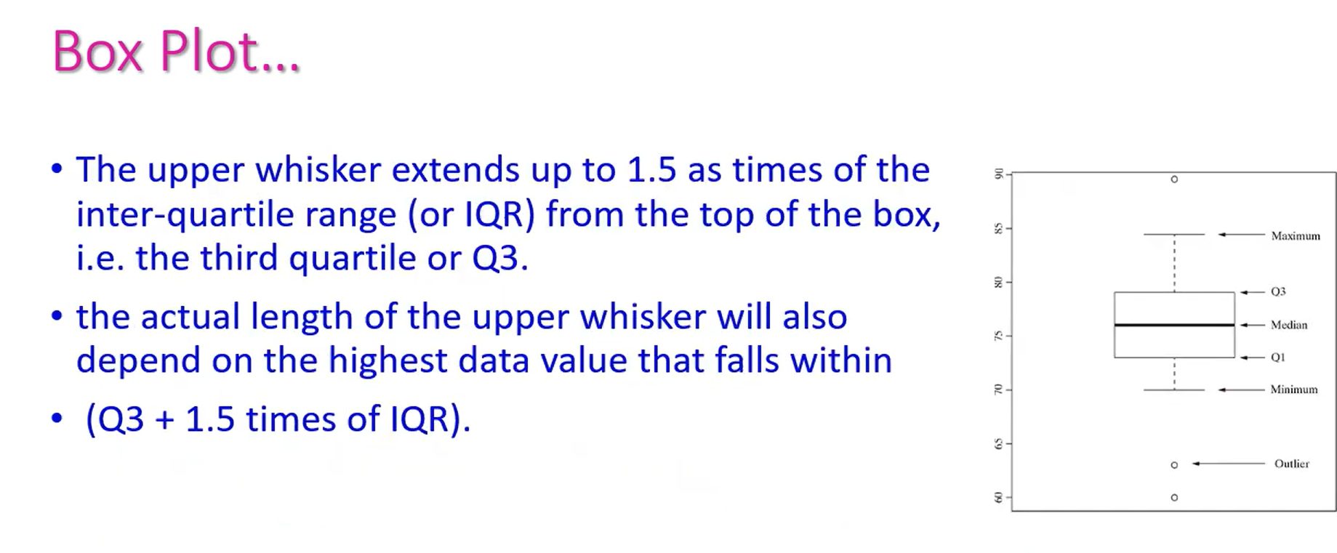

Slide 77
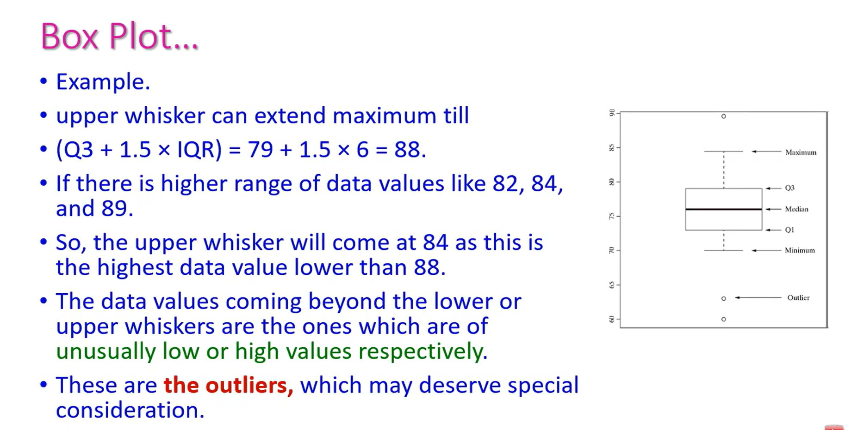

Slide 78
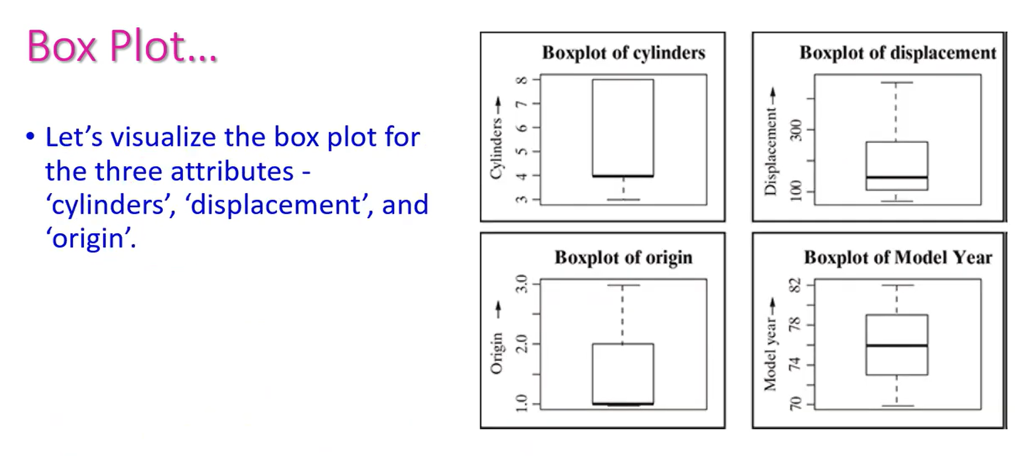

Slide 79
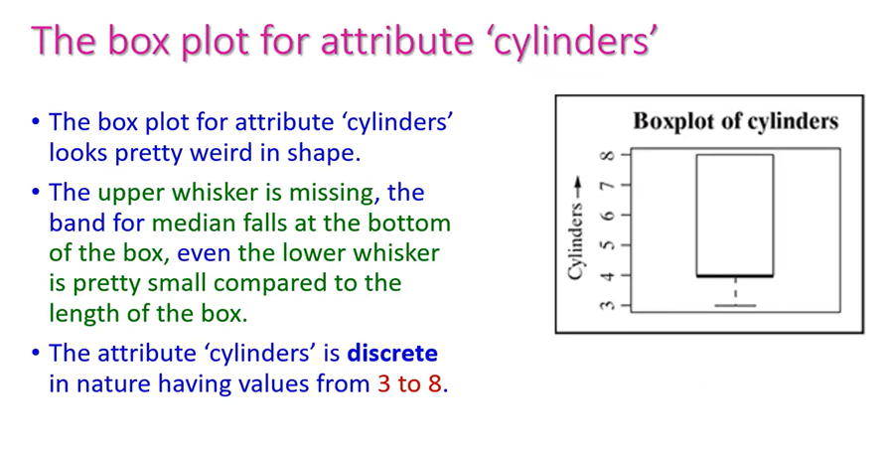

Slide 80
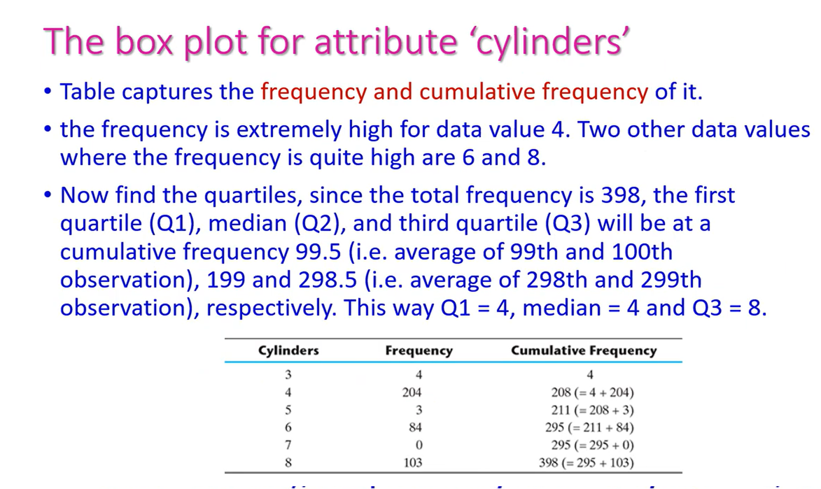

Slide 81
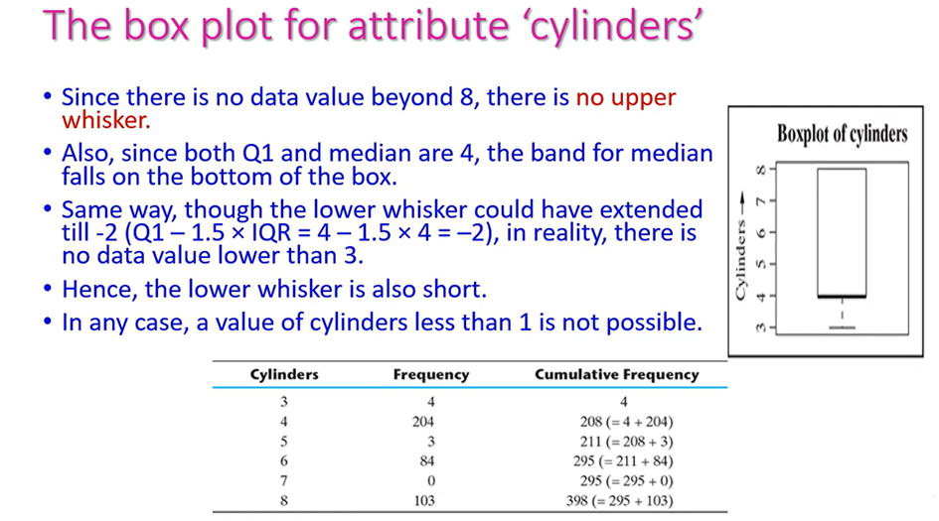

Slide 82
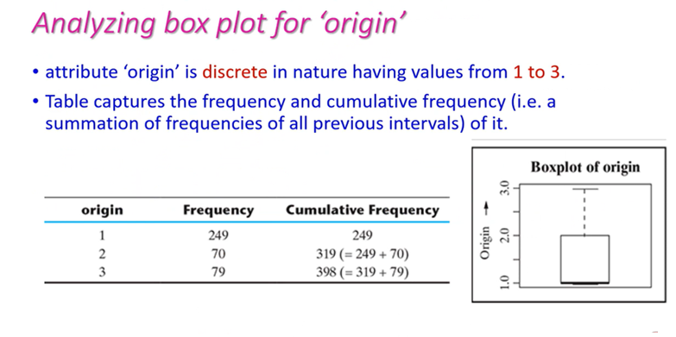

Slide 83
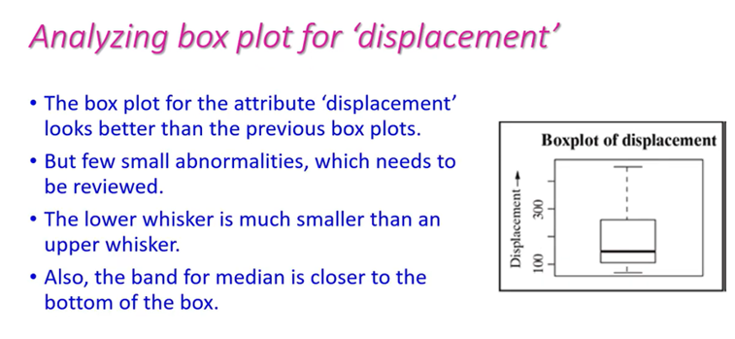

Slide 84


Slide 85


Slide 86


Slide 87

EXPLORING STRUCTURE OF DATA
Plotting and exploring numerical data
Histogram

Slide 88


EXPLORING STRUCTURE OF DATA
Plotting and exploring numerical data

Slide 89

EXPLORING STRUCTURE OF DATA
Plotting and exploring numerical data
Analysing box plot for ‘cylinders’
Q1 = 1
Q2 = 4
Q3 = 8
NO UPPER WHISK SINCE Q3=8
Frequency of “Cylinders” Attribute
the lower whisker could have extended till -2
(Q1 – 1.5 × IQR = 4 – 1.5 × 4 = –2),
in reality, there is no data value lower than 3. Hence, the lower whisker is also short.

Slide 90

EXPLORING STRUCTURE OF DATA
Plotting and exploring numerical data
Histogram
The focus of histogram is to plot ranges of data values (acting as ‘bins’), the number of data elements in each range will depend on the data distribution. Based on that, the size of each bar corresponding to the different ranges will vary.
Histograms might be of different shapes depending on the nature of the data

Slide 91
EXPLORING STRUCTURE OF DATA
Plotting and exploring numerical data
Histogram

Slide 92
EXPLORING STRUCTURE OF DATA
Exploring categorical data
For attribute ‘car name’
1. Chevrolet chevelle malibu
2. Buick skylark 320
3. Plymouth satellite
4. Amc rebel sst
5. Ford torino
6. Ford galaxie 500
7. Chevrolet impala
8. Plymouth fury iii
9. Pontiac catalina
10. Amc ambassador dpl
For attribute ‘cylinders’
8 4 6 3 5

Slide 93


EXPLORING STRUCTURE OF DATA
Exploring categorical data
Count of Categories for ‘car name’ Attribute
Count of Categories for ‘Cylinders’ Attribute

Slide 94


Slide 95


EXPLORING STRUCTURE OF DATA
Exploring categorical data
Proportion of Categories for ‘“Cylinders’ Attribute
Proportion of Categories for “Cylinders” Attribute

Slide 96

EXPLORING STRUCTURE OF DATA
Exploring relationship between variables
Scatter plot
visualizing bivariate relationships, i.e.
relationship between two variables.
Scatter plot of ‘displacement’ and ‘mpg’

Slide 97

EXPLORING STRUCTURE OF DATA
Exploring relationship between variables
Pair wise scatter plot between different attributes of Auto MPG

Slide 98


EXPLORING STRUCTURE OF DATA
Two-way cross-tabulations
Two-way cross-tabulations (also called cross-tab or contingency table) are used to understand the relationship of two categorical attributes
It has a matrix format that presents a summarized view of the bivariate frequency distribution.
‘Model year’ vs. ‘origin’
‘Cylinders’ vs. ‘Origin’

Slide 99

EXPLORING STRUCTURE OF DATA
Two-way cross-tabulations
Cross-tab for ‘Cylinders’ vs. ‘Model year’

Slide 100

Plotting and exploring numerical data - Box plots
A box plot is an extremely effective mechanism to get a one-shot view and understand the nature of the data.

Slide 101
The central rectangle or the box spans from first to third quartile (i.e. Q1 to Q3), thus giving the inter-quartile range (IQR).
Median is given by the line or band within the box.
The lower whisker extends up to 1.5 times of the inter-quartile range (or IQR) from the bottom of the box, i.e. the first quartile or Q1. However, the actual length of the lower whisker depends on the lowest data value that falls within (Q1 − 1.5 times of IQR). Let’s try to understand this with an example. Say for a specific set of data, Q1 = 73, median = 76 and Q3 = 79. Hence, IQR will be 6 (i.e. Q3 – Q1).So, lower whisker can extend maximum till (Q1 – 1.5 × IQR) = 73 – 1.5 × 6 = 64. However, say there are lower range data values such as 70, 63, and 60. So, the lower whisker will come at 70 as this is the lowest data value larger than 64.
The upper whisker extends up to 1.5 as times of the inter-quartile range (or IQR) from the top of the box, i.e. the third quartile or Q3. Similar to lower whisker, the actual length of the upper whisker will also depend on the highest data value that falls within (Q3 + 1.5 times of IQR). Let’s try to understand this with an example. For the same set of data mentioned in the above point, upper whisker can extend maximum till (Q3 + 1.5 × IQR) = 79 + 1.5 × 6 = 88. If there is higher range of data values like 82, 84, and 89. So, the upper whisker will come at 84 as this is the highest data value lower than 88.
The data values coming beyond the lower or upper whiskers are the ones which are of unusually low or high values respectively. These are the outliers, which may deserve special consideration

Slide 102

Let’s visualize the box plot for the three attributes - ‘cylinders’, ‘displacement’, and ‘origin’. We will also review the box plot of another attribute in which the deviation between mean and median is very little and see what the basic difference in the respective box plots

Slide 103

Analysing box plot for ‘cylinders’

Slide 104
Analysing box plot for ‘origin’
Like the box plot for attribute ‘cylinders’, the box plot for attribute ‘cylinders’ also looks pretty weird in shape. Here the lower whisker is missing and the band for median falls at the bottom of the box!

Slide 105


Slide 106

Analysing box plot for ‘displacement’
The box plot for the attribute ‘displacement’ looks better than the previous box plots. However, still, there are few small abnormalities, the cause of which needs to be reviewed. Firstly, the lower whisker is much smaller than an upper whisker. Also, the band for median is closer to the bottom of the box.

Slide 107


Slide 108

Analysing box plot for ‘model Year’
Difference between Q1 and minimum data value (i.e. 70) is also same as maximum data value (i.e. 82) and Q3 (both are 3). So both lower and upper whiskers are expected to be of the same size which is 33% [3 / (1.5 × 6)] of the permissible length.

Slide 109
UNIT I INTRODUCTION 9+6
Machine Learning – Types – Applications – Preparing to Model – Activities – Data – Exploring structure of Data – Data Quality and Remediation – Data Pre-processing – Modelling and Evaluation: Selecting a Model -Training a Model – Model representation and Interpretability – Evaluating Performance of a Model – Improving Performance.

Slide 110
DATA QUALITY AND REMEDIATION
Data quality
Success of machine learning depends largely on the quality of data. A data which has the right quality helps to achieve better prediction accuracy
two types of problems:
1. Certain data elements without a value or data with a missing value.
2. Data elements having value surprisingly different from the other elements, which we term as outliers.
There are multiple factors which lead to these data quality issues. Following are some of them:
Incorrect sample set selection:
Errors in data collection:

Slide 111
DATA QUALITY AND REMEDIATION
Data remediation
The issues in data quality, need to be remediated, if the right amount of efficiency has to be achieved in the learning activity.
Handling outliers
Remove outliers: If the number of records which are outliers is not many, a
simple approach may be to remove them.
Imputation: One other way is to impute the value with mean or median or mode. The value of the most similar data element may also be used for imputation.
Capping: For values that lie outside the 1.5|×| IQR limits, we can cap them by replacing those observations below the lower limit with the value of 5th percentile and those that lie above the upper limit, with the value of 95th percentile.

Slide 112

DATA QUALITY AND REMEDIATION
Data remediation
Handling missing values
Eliminate records having a missing value of data elements
Imputing missing values
Estimate missing values
Missing Values for ‘Horsepower’ Attribute

Slide 113
UNIT I INTRODUCTION 9+6
Machine Learning – Types – Applications – Preparing to Model – Activities – Data – Exploring structure of Data – Data Quality and Remediation – Data Pre-processing – Modelling and Evaluation: Selecting a Model -Training a Model – Model representation and Interpretability – Evaluating Performance of a Model – Improving Performance.

Slide 114
DATA PRE-PROCESSING
Dimensionality reduction
Feature subset selection
High-dimensional data sets need a high amount of computational space and time. At the same time, not all
features are useful – they degrade the performance of machine learning algorithms.
Approaches
PCA- principal component analysis -Dimensionality reduction refers to the techniques of reducing the dimensionality of a data set by creating new attributes by combining the original attributes. The most common approach for dimensionality reduction is known as Principal Component Analysis (PCA).
PCA is a statistical technique to convert a set of correlated variables into a set of transformed, uncorrelated variables called principal components.
The principal components are a linear combination of the original variables. They are orthogonal to each other. Since principal components are uncorrelated, they capture the maximum amount of variability in the data. However, the only challenge is that the original attributes are lost due to the transformation.
Another commonly used technique which is used for dimensionality reduction is Singular Value Decomposition (SVD).

Slide 115
DATA QUALITY AND REMEDIATION
Data quality :
A data which has the right quality helps to achieve better prediction accuracy, in case of supervised learning. However, it is not realistic to expect that the data will be flawless. We have already come across at least two types of problems:
1. Certain data elements without a value or data with a missing value. 2. Data elements having value surprisingly different from the other elements, which we term as outliers.
Incorrect sample set selection: The data may not reflect normal or regular quality due to incorrect selection of sample set.
Errors in data collection: resulting in outliers and missing values

Slide 116
Data remediation
The issues in data quality, as mentioned above, need to be remediated, if the right amount of efficiency has to be achieved in the learning activity.
Handling outliers
Outliers are data elements with an abnormally high value which may impact prediction accuracy, especially in regression models.
. However, if the outliers are natural, i.e. the value of the data element is surprisingly high or low because of a valid reason, then we should not amend it

Slide 117
Remove outliers: If the number of records which are outliers is not many, a simple approach may be to remove them.
Imputation: One other way is to impute the value with mean or median or mode. The value of the most similar data element may also be used for imputation.
Capping: For values that lie outside the 1.5|×| IQR limits, we can cap them by replacing those observations below the lower limit with the value of 5th percentile and those that lie above the upper limit, with the value of 95th percentile.

Slide 118
If there is a significant number of outliers, they should be treated separately in the statistical model. In that case, the groups should be treated as two different groups, the model should be built for both groups and then the output can be combined.
Handling missing values
it can be caused by omission on part of the surveyor or a person who is collecting sample data or by the responder, primarily due to his/her unwillingness to respond or lack of understanding needed to provide a response.

Slide 119
Eliminate records having a missing value of data elements
Imputing missing values
Imputation is a method to assign a value to the data elements having missing values. Mean/mode/median is most frequently assigned value. For quantitative attributes, all missing values are imputed with the mean, median, or mode of the remaining values under the same attribute. For qualitative attributes, all missing values are imputed by the mode of all remaining values of the same attribute. However, another strategy may be identify the similar types of observations whose values are known and use the mean/median/mode of those known values.
Estimate missing values

Slide 120
DATA PRE-PROCESSING
Dimensionality reduction
High-dimensional data sets need a high amount of computational space and time. At the same time, not all features are useful – they degrade the performance of machine learning algorithms. Most of the machine learning algorithms perform better if the dimensionality of data set, i.e. the number of features in the data set, is reduced. Dimensionality reduction helps in reducing irrelevance and redundancy in features. Also, it is easier to understand a model if the number of features involved in the learning activity is less.

Slide 121
Dimensionality reduction refers to the techniques of reducing the dimensionality of a data set by creating new attributes by combining the original attributes. The most common approach for dimensionality reduction is known as Principal Component Analysis (PCA).
PCA is a statistical technique to convert a set of correlated variables into a set of transformed, uncorrelated variables called principal components. The principal components are a linear combination of the original variables. They are orthogonal to each other. Since principal components are uncorrelated, they capture the maximum amount of variability in the data. However, the only challenge is that the original attributes are lost due to the transformation.
Another commonly used technique which is used for dimensionality reduction is Singular Value Decomposition (SVD).

Slide 122
Feature subset selection
Feature subset selection or simply called feature selection, both for supervised as well as unsupervised learning, try to find out the optimal subset of the entire feature set which significantly reduces computational cost without any major impact on the learning accuracy. It may seem that a feature subset may lead to loss of useful information as certain features are going to be excluded from the final set of features used for learning. However, for elimination only features which are not relevant or redundant are selected.

Slide 123
A feature is considered as irrelevant if it plays an insignificant role (or contributes almost no information) in classifying or grouping together a set of data instances. All irrelevant features are eliminated while selecting the final feature subset. A feature is potentially redundant when the information contributed by the feature is more or less same as one or more other features. Among a group of potentially redundant features, a small number of features can be selected as a part of the final feature subset without causing any negative impact to learn model accuracy

Slide 124
UNIT I INTRODUCTION 9+6
Machine Learning – Types – Applications – Preparing to Model – Activities – Data – Exploring structure of Data – Data Quality and Remediation – Data Pre-processing – Modelling and Evaluation: Selecting a Model -Training a Model – Model representation and Interpretability – Evaluating Performance of a Model – Improving Performance.

Slide 125
Modelling and Evaluation

Slide 126
Modelling and Evaluation
SELECTING A MODEL
Predictive models
Descriptive models
TRAINING A MODEL (FOR SUPERVISED LEARNING)
Holdout method
K-fold Cross-validation method
Bootstrap sampling
Lazy vs. Eager learner

Slide 127
Modelling and Evaluation
When we talk about the learning process, abstraction is a significant step as it represents raw input data in a summarized and structured format, such that a meaningful insight is obtained from the data. This structured representation of raw input data to the meaningful pattern is called a model.
The model might have different forms. It might be a mathematical equation, it might be a graph or tree structure, it might be a computational block, etc. The decision regarding which model is to be selected for a specific data set is taken by the learning task, based on the problem to be solved and the type of data.
For example, when the problem is related to prediction and the target field is numeric and continuous, the regression model is assigned. The process of assigning a model, and fitting a specific model to a data set is called model training. Once the model is trained, the raw input data is summarized into an abstracted form.

Slide 128
A machine learning algorithm creates its cognitive capability by building a mathematical formulation or function, known as target function, based on the features in the input data set.
Just like a child learning things for the first time needs her parents guidance to decide whether she is right or wrong, in machine learning someone has to provide some non-learnable parameters, also called hyper-parameters.

Slide 129
SELECTING A MODEL
In machine learning paradigm, the potential causes of disturbance, e.g. average income of the local population, weapon sales, the inflow of immigrants, etc. are input variables. They are also called predictors, attributes, features, independent variables, or simply variables. The number of criminal incidents is an output variable (also called response or dependent variable). Input variables can be denoted by X, while individual input variables are represented as X , X , X , …, X and output variable by symbol Y. The relationship between X and Y is represented in the general form: Y = f (X) + e, where ‘f ’ is the target function and ‘e’ is a random error term.

Slide 130
Predictive models
Models for supervised learning or predictive models, as is understandable from the name itself, try to predict certain value using the values in an input data set. The learning model attempts to establish a relation between the target feature, i.e. the feature being predicted, and the predictor features. The predictive models have a clear focus on what they want to learn and how they want to learn.
. Below are some examples:
1. Predicting win/loss in a cricket match
2. Predicting whether a transaction is fraud
3. Predicting whether a customer may move to another product

Slide 131
The models which are used for prediction of target features of categorical value are known as classification models. The target feature is known as a class and the categories to which classes are divided into are called levels. Some of the popular classification models include k-Nearest Neighbor (kNN), Naïve Bayes, and Decision Tree.
Predictive models may also be used to predict numerical values of the target feature based on the predictor features. Below are some examples:
1. Prediction of revenue growth in the succeeding year
2. Prediction of rainfall amount in the coming monsoon
3. Prediction of potential flu patients and demand for flu shots next winter
The models which are used for prediction of the numerical value of the target feature of a data instance are known as regression models. Linear Regression and Logistic Regression models are popular regression models.

Slide 132
Categorical values can be converted to numerical values and vice versa. For example, for stock price growth prediction, any growth percentage lying between certain ranges may be represented by a categorical value, e.g. 0%–5% as ‘low’, 5%–10% as ‘moderate’, 10%–20% as ‘high’ and > 20% as ‘booming’. In a similar way, a categorical value can be converted to numerical value, e.g. in the tumor malignancy detection problem, replace ‘benign’ as 0 and ‘malignant’ as 1. This way, the models can be used interchangeably, though it may not work always.
There are multiple factors to be considered while selecting a model. For example, while selecting the model for prediction, the training data size is an important factor to be considered. If the training data set is small, low variance models like Naïve Bayes are supposed to perform better because model overfitting needs to be avoided in this situation. Similarly, when the training data is large, low bias models like logistic regression should be preferred because they can represent complex relationships in a more effective way.

Slide 133
Modelling and Evaluation
The basic learning process
1. Data Input
2. Abstraction
3. Generalization
Structured representation of raw input data to the meaningful pattern is called a model.
It will be in Different forms
The process of assigning a model, and fitting a specific model to a data set is called model training.
If the outcome is systematically incorrect, the learning is said to have a bias.
SELECTING A MODEL
Input variables can be denoted by X, while individual input variables are represented as X 1, X 2, X 3,……., X n and output variable by symbol Y.
The relationship between X and Y is represented in the general form:
Y = f (X) + e,
where ‘f ’ is the target function and ‘e’ is a random error term.

Slide 134
Modelling and Evaluation
A cost function (also called error function) helps to measure the extent to which the model is going wrong in estimating the relationship between X and Y. In that sense, cost function can tell how bad the model is performing. For example, R-squared (to be discussed later in this chapter) is a cost function of regression model.
Loss function is almost synonymous to cost function – only difference being loss function is usually a function defined on a data point, while cost function is for the entire training data set.
Machine learning is an optimization problem. We try to define a model and tune the parameters to find the most suitable solution to a problem.However, we need to have a way to evaluate the quality or optimality of a solution. This is done using objective function. Objective means goal.

Slide 135
A cost function (also called error function) helps to measure the extent to which the model is going wrong in estimating the relationship between X and Y. In that sense, cost function can tell how bad the model is performing. For example, R-squared is a cost function of regression model.
Loss function is almost synonymous to cost function – only difference being loss function is usually a function defined on a data point, while cost function is for the entire training data set.
Machine learning is an optimization problem. We try to define a model and tune the parameters to find the most suitable solution to a problem. However, we need to have a way to evaluate the quality or optimality of a solution. This is done using objective function. Objective means goal.
Objective function takes in data and model (along with parameters) as input and returns a value. Target is to find values of model parameter to maximize or minimize the return value. When the objective is to minimize the value, it becomes synonymous to cost function. Examples : maximize the reward function in reinforcement learning, maximize the posterior probability in Naive Bayes, minimize squared error in regression.

Slide 136
Multiple factors play a role when we try to select the model for solving a machine learning problem. The most important factors are (i) the kind of problem we want to solve using machine learning and (ii) the nature of the underlying data.
The problem may be related to the prediction of a class value like whether a tumour is malignant or benign, whether the next day will be snowy or rainy, etc. It may be related to prediction – but of some numerical value like what the price of a house should be in the next quarter, what is the expected growth of a certain IT stock in the next 7 days, etc.
Machine learning algorithms are broadly of two types: models for supervised learning, which primarily focus on solving predictive problems and models for unsupervised learning, which solve descriptive problems.

Slide 137
Descriptive models
Models for unsupervised learning or descriptive models are used to describe a data set or gain insight from a data set. There is no target feature or single feature of interest in case of unsupervised learning. Based on the value of all features, interesting patterns or insights are derived about the data set.
Descriptive models which group together similar data instances, i.e. data instances having a similar value of the different features are called clustering models.
Descriptive models which group together similar data instances, i.e. data instances having a similar value of the different features are called clustering models. Examples of clustering include
1. Customer grouping or segmentation based on social, demographic, ethnic, etc. factors
2. Grouping of music based on different aspects like genre, language, timeperiod, etc.
3. Grouping of commodities in an inventory

Slide 138
The most popular model for clustering is k-Means.
Descriptive models related to pattern discovery is used for market basket analysis of transactional data.

Slide 139
Modelling and Evaluation
1. Supervised
1. Classification
2. Regression
2. Unsupervised
1. Clustering
2. Association analysis
3. Reinforcement
Predictive models
Try to predict certain value using the values in an input data set. The learning model attempts to establish a relation between the target feature, i.e.the feature being predicted, and the predictor features.
some examples:
1. Predicting win/loss in a cricket match
2. Predicting whether a transaction is fraud
3. Predicting whether a customer may move to another product

Slide 140
Modelling and Evaluation
Predictive models
predict numerical values
1. Prediction of revenue growth in the succeeding year
2. Prediction of rainfall amount in the coming monsoon
3. Prediction of potential flu patients and demand for flu shots next winter
Descriptive models
There is no target feature or single feature of interest in case of unsupervised learning. Based on the value of all features,interesting patterns or insights are derived about the data set.
Examples of clustering include
1. Customer grouping or segmentation based on social, demographic, ethnic, etc. factors
2. Grouping of music based on different aspects like genre, language, timeperiod,etc.
3. Grouping of commodities in an inventory
The most popular model for clustering is k-Means.

Slide 141
UNIT I INTRODUCTION 9+6
Machine Learning – Types – Applications – Preparing to Model – Activities – Data – Exploring structure of Data – Data Quality and Remediation – Data Pre-processing – Modelling and Evaluation: Selecting a Model -Training a Model – Model representation and Interpretability – Evaluating Performance of a Model – Improving Performance.

Slide 142
Modelling and Evaluation
TRAINING A MODEL (FOR SUPERVISED LEARNING)
Holdout method
K-fold Cross-validation method
Bootstrap sampling
Lazy vs. Eager learner

Slide 143

Modelling and Evaluation
TRAINING A MODEL (FOR SUPERVISED LEARNING)
Holdout method
Holding back a part of the input data for validating the trained model is known as holdout method.
Holdout method

Slide 144
TRAINING A MODEL (FOR SUPERVISED LEARNING)
Holdout method :
The test data may not be available immediately. Also, the label value of the test data is not known. That is the reason why a part of the input data is held back (that is how the name holdout originates) for evaluation of the model. This subset of the input data is used as the test data for evaluating the performance of a trained model. In general 70%–80% of the input data (which is obviously labelled) is used for model training. The remaining 20%–30% is used as test data for validation of the performance of the model. However, a different proportion of dividing the input data into training and test data is also acceptable. To make sure that the data in both the buckets are similar in nature, the division is done randomly. Random numbers are used to assign data items to the partitions. This method of partitioning the input data into two parts – training and test data which is by holding back a part of the input data for validating the trained model is known as holdout method.

Slide 145


Slide 146
Once the model is trained using the training data, the labels of the test data are predicted using the model’s target function. Then the predicted value is compared with the actual value of the label. This is possible because the test data is a part of the input data with known labels. The performance of the model is in general measured by the accuracy of prediction of the label value.
In certain cases, the input data is partitioned into three portions – a training and a test data, and a third validation data. The validation data is used in place of test data, for measuring the model performance. It is used in iterations and to refine the model in each iteration. The test data is used only for once, after the model is refined and finalized, to measure and report the final performance of the model as a reference for future learning efforts.

Slide 147
Modelling and Evaluation
TRAINING A MODEL (FOR SUPERVISED LEARNING)
Holdout method
The input data is partitioned into three portions – a training and a test data, and a third validation data.
The validation data is used in place of test data, for measuring the model performance. It is used in iterations and to refine the model in each iteration. The test data is used only for once, after the model is refined and finalized, to measure and report the final performance of the model as a reference for future learning efforts.
Problem → if data may not be proportionate
solution→ applying stratified random sampling in place of sampling.

Slide 148
Modelling and Evaluation
TRAINING A MODEL (FOR SUPERVISED LEARNING)
K-fold Cross-validation method
The process of repeated holdout is the basis of k-fold cross-validation technique.
In k-fold cross-validation, the data set is divided into k-completely distinct or non-overlapping random partitions called folds
there are two approaches which are extremely popular:
1. 10-fold cross-validation (10-fold CV)
2. Leave-one-out cross-validation (LOOCV)

Slide 149

Modelling and Evaluation
K-fold Cross-validation method

Slide 150

Modelling and Evaluation
K-fold Cross-validation method
Detailed approach for fold selection

Slide 151









K Fold Cross Validation

Slide 152


K Fold Cross Validation Example K=5

Slide 153

K Fold Cross Validation Example K=5

Slide 154

K Fold Cross Validation Example K=5

Slide 155

K Fold Cross Validation Example K=5

Slide 156

K Fold Cross Validation Example K=5

Slide 157

K Fold Cross Validation Example K=5

Slide 158

K Fold Cross Validation

Slide 159

K Fold Cross Validation

Slide 160

Modelling and Evaluation
TRAINING A MODEL (FOR SUPERVISED LEARNING)
Bootstrap sampling
It uses the technique of Simple Random Sampling with Replacement (SRSWR), which is a well-known technique in sampling theory for drawing random samples

Slide 161
Modelling and Evaluation
TRAINING A MODEL (FOR SUPERVISED LEARNING)
Eger / Lazy Learner
Eger → The general principles of machine learning – it tries to construct a generalized, input-independent target function during the model training phase,
Eager learning approach include Decision Tree, Support Vector Machine, Neural Network, etc.
Lazy → completely skips the abstraction and generalization processes.
lazy learner doesn’t ‘learn’ anything
It uses the training data in exact, and uses the knowledge to classify the unlabelled test data.
rote learning (i.e. memorization technique based on repetition).
Instance learning.
They are also called non-parametric learning
take very little time in training
Popular algorithm for lazy learning is k-nearest neighbor.

Slide 162


Slide 163
UNIT I INTRODUCTION 9+6
Machine Learning – Types – Applications – Preparing to Model – Activities – Data – Exploring structure of Data – Data Quality and Remediation – Data Pre-processing – Modelling and Evaluation: Selecting a Model -Training a Model – Model representation and Interpretability – Evaluating Performance of a Model – Improving Performance.

Slide 164
MODEL REPRESENTATION AND INTERPRETABILITY

Slide 165
MODEL REPRESENTATION AND INTERPRETABILITY
Underfitting
Overfitting
Bias – variance trade-off
Errors due to ‘Bias’
Errors due to ‘Variance’

Slide 166
Model Representation and Interpretability

Slide 167
Model Representation and Interpretability
Underfitting
Overfitting
Bias – variance trade-off
Errors due to ‘Bias’
Errors due to ‘Variance’
Fitness of a target function approximated by a learning algorithm determines how correctly it is able to classify a set of data it has never seen

Slide 168

Model Representation and Interpretability
Underfitting
A typical case of underfitting may occur when trying to represent a non-linear data with a linear model as demonstrated by both cases of underfitting shown in figure.
Many times underfitting happens due to unavailability of sufficient training data.
Underfitting results in both poor performance with training data as well as poor generalization to test data.
Underfitting can be avoided by
1. using more training data
2. reducing features by effective feature selection
Underfitting and Overfitting of models

Slide 169
Model Representation and Interpretability
Overfitting
Overfitting results in good performance with training data set,but poor generalization and hence poor performance with test data set.
Overfitting can be avoided by
1. Using re-sampling techniques like k-fold cross validation
2. Hold back of a validation data set
3. Remove the nodes which have little or no predictive power for the given machine learning problem.
Underfitting and Overfitting of models

Slide 170


Slide 171
Bias – variance trade-off
In supervised learning, the class value assigned by the learning model built based on the training data may differ from the actual class value. This error in learning can be of two types –errors due to ‘bias’ and error due to ‘variance’

Slide 172
Errors due to ‘Bias’
It is due to underfitting of the model
Parametric models generally have high bias making them easier to understand/interpret and faster to learn.
Underfitting results in high bias.
Errors due to ‘Variance’
Errors due to variance occur from difference in training data sets used to train the model.
Different training data sets (randomly sampled from the input data set) are used to train the model.
Increasing the bias will decrease the variance,
Increasing the variance will decrease the bias

Slide 173
UNIT I INTRODUCTION 9+6
Machine Learning – Types – Applications – Preparing to Model – Activities – Data – Exploring structure of Data – Data Quality and Remediation – Data Pre-processing – Modelling and Evaluation: Selecting a Model -Training a Model – Model representation and Interpretability – Evaluating Performance of a Model – Improving Performance.

Slide 174
EVALUATING PERFORMANCE OF A MODEL

Slide 175

EVALUATING PERFORMANCE OF A MODEL
Supervised learning – classification
TP→ the model has correctly classified data
instances as the class of interest
TN→ he model has correctly classified as not
the class of interest.
FP → the model incorrectly classified data
instances as the class of interest.
FN → the model has incorrectly classified as not
the class of interest.
Madel Accuracy
There are four possibilities with regards to the cricket match
win/loss prediction:
1. the model predicted win and the team won
2. the model predicted win and the team lost
3. the model predicted loss and the team won
4. the model predicted loss and the team lost

Slide 176

EVALUATING PERFORMANCE OF A MODEL

Slide 177

EVALUATING PERFORMANCE OF A MODEL
A matrix containing correct and incorrect predictions in the form of TPs, FPs, FNs and TNs is known as confusion matrix.

Slide 178



EVALUATING PERFORMANCE OF A MODEL
Let’s assume the confusion matrix of the win/loss prediction of cricket match problem to be as below:
In context of the above confusion matrix, total count of TPs= 85, count of FPs = 4, count of FNs = 2 and count of TNs = 9.
The percentage of misclassifications is indicated using error rate which is measured as

Slide 179



EVALUATING PERFORMANCE OF A MODEL
Sometimes, correct prediction, both TPs as well as TNs,may happen by mere coincidence. Since these occurrences boost model accuracy, ideally it should not happen. Kappa value of a model indicates the adjusted the model accuracy. It is calculated using the formula below:

Slide 180

EVALUATING PERFORMANCE OF A MODEL
In context of the above confusion matrix, total count of TPs= 85, count of FPs = 4, count of FNs = 2 and count of TNs = 9.

Slide 181

EVALUATING PERFORMANCE OF A MODEL
In Some problems (Ex. Medical Health care) there are some measures of model performance which are more important than accuracy.Two such critical measurements are sensitivity and specificity of the model.
The sensitivity of a model measures the proportion of TP examples or positive cases which were correctly classified. It is measured as
A high value of
sensitivity is more desirable than a high value of accuracy.
Specificity of a model measures the proportion of negative examples which have been correctly classified.
A higher value of specificity will indicate a better model
performance.

Slide 182

EVALUATING PERFORMANCE OF A MODEL

Slide 183



EVALUATING PERFORMANCE OF A MODEL
Precision
While precision gives the proportion of positive predictions which are truly positive, recall gives the proportion of TP cases over all actually positive cases.
Recall
Recall indicates the proportion of correct prediction of positives to the total number of positives
F-measure
F-measure is another measure of model performance which combines the precision and recall. It takes the harmonic mean of precision and recall as calculated as

Slide 184



EVALUATING PERFORMANCE OF A MODEL
Supervised learning – regression
The distance between the actual value and the fitted or predicted value, i.e. y is known as residual.
R-squared is a good measure to evaluate the model fitness.
The R-squared value lies between 0 to 1 (0%–100%) with a larger value representing a better fit. It is calculated as:
Sum of Squares Total (SST) = squared differences of each
observation from the overall mean = $\sum_{i=1}^{n}{{\left(y_{i}−\overline{y}\right)}^{2}}$ where $\overline{y}$is the mean.
Sum of Squared Errors (SSE) (of prediction) = sum of the
squared residuals = $\sum_{i=1}^{n}{{\left(Yi−{\hat{y}}_{i}\right)}^{2}}$ where ${\hat{y}}_{i}$ is the predicted value of y and Yi is the actual value of y

Slide 185
EVALUATING PERFORMANCE OF A MODEL
Unsupervised learning - clustering
Two inherent challenges which lie in the process of clustering:
1. It is generally not known how many clusters can be formulated from a particular data set. It is completely open-ended in most cases and provided as a user input to a clustering algorithm.
2. Even if the number of clusters is given, the same number of clusters can be formed with different groups of data instances.
Approaches which are adopted for cluster quality evaluation
1. Internal evaluation
2. External evaluation

Slide 186




EVALUATING PERFORMANCE OF A MODEL
Unsupervised learning - clustering
1. Internal evaluation
homogeneity of data belonging to the same cluster and heterogeneity of data belonging to different clusters.
silhouette coefficient

Slide 187

EVALUATING PERFORMANCE OF A MODEL
Unsupervised learning - clustering
1.External evaluation
In this approach, class label is known for the data set subjected to clustering.
Purity is one of the most popular measures of cluster algorithms – evaluates the extent to which clusters contain a single class.
For a data set having ‘n’ data instances and ‘c’ known class labels which generate ‘k’ clusters, purity is measured as:

Slide 188
UNIT I INTRODUCTION 9+6
Machine Learning – Types – Applications – Preparing to Model – Activities – Data – Exploring structure of Data – Data Quality and Remediation – Data Pre-processing – Modelling and Evaluation: Selecting a Model -Training a Model – Model representation and Interpretability – Evaluating Performance of a Model – Improving Performance.

Slide 189
IMPROVING PERFORMANCE OF A MODEL

Slide 190
IMPROVING PERFORMANCE OF A MODEL
The model selection is done one several aspects:
1. Type of learning the task in hand, i.e. supervised or unsupervised
2. Type of the data, i.e. categorical or numeric
3. Sometimes on the problem domain
4. Above all, experience in working with different models to solve problems of diverse domains
One effective way to improve model performance is by tuning model parameter. Model parameter tuning is the process of adjusting the model fitting options
As an alternate approach of increasing the performance of one model,
This approach of combining different models with diverse strengths is known as ensemble

Slide 191
IMPROVING PERFORMANCE OF A MODEL
Ensemble
Following are the typical steps in ensemble process:
Build a number of models based on the training data
For diversifying the models generated, the training data subset can be varied using the allocation function. Sampling techniques like bootstrapping may be used to generate unique training data sets.
Alternatively, the same training data may be used but the models combined are quite varying, e.g, SVM, neural network, kNN, etc.
The outputs from the different models are combined using a combination function. A very simple strategy of combining, say in case of a prediction task using ensemble, can be majority voting of the different models combined. For example, 3 out of 5 classes predict ‘win’ and 2 predict ‘loss’ – then the final outcome of the ensemble using majority vote would be a ‘win’

Slide 192

IMPROVING PERFORMANCE OF A MODEL
Ensemble

